Slide 2
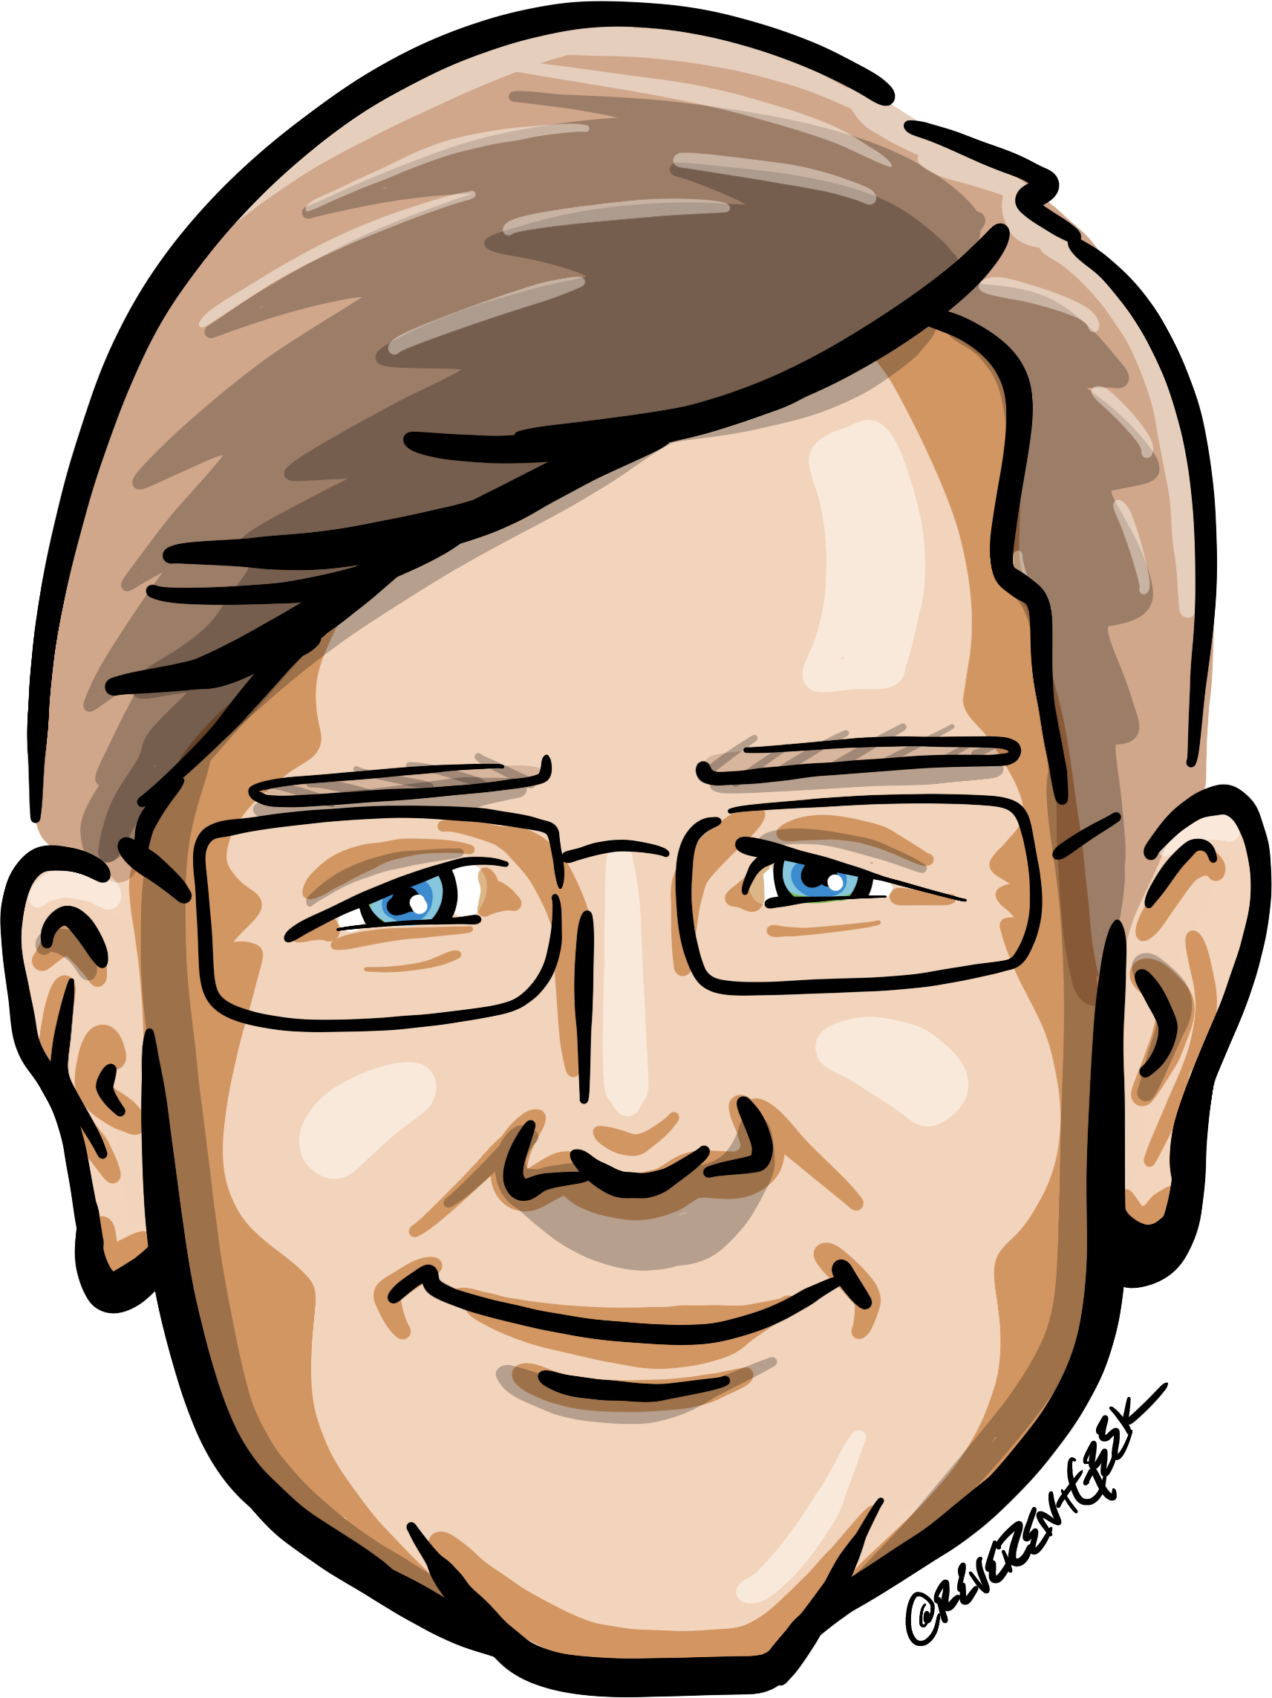





Who is Chad Green
chadgreen@chadgreen.com
TaleLearnCode
ChadGreen.com
ChadGreen & TaleLearnCode
ChadwickEGreen

Slide 3
What is Software Craftsmanship
Software Craftsmanship for New Developers

Slide 4
What Software Craftsmanship is not
Beautiful Code

Slide 5
What Software Craftsmanship is not
Beautiful Code

Slide 6
What Software Craftsmanship is not
Beautiful Code
Test-Driven Development

Slide 7
What Software Craftsmanship is not
Beautiful Code
Test-Driven Development

Slide 8
What Software Craftsmanship is not
Beautiful Code
Test-Driven Development
Self-Selected Group of People

Slide 9
What Software Craftsmanship is not
Beautiful Code
Test-Driven Development
Self-Selected Group of People

Slide 10
What Software Craftsmanship is not
Beautiful Code
Test-Driven Development
Self-Selected Group of People
Specific Technologies or Methodologies

Slide 11
What Software Craftsmanship is not
Beautiful Code
Test-Driven Development
Self-Selected Group of People
Specific Technologies or Methodologies

Slide 12
What Software Craftsmanship is not
Beautiful Code
Test-Driven Development
Self-Selected Group of People
Certifications
Specific Technologies or Methodologies

Slide 13
What Software Craftsmanship is not
Beautiful Code
Test-Driven Development
Self-Selected Group of People
Certifications
Specific Technologies or Methodologies

Slide 14
What Software Craftsmanship is not
Beautiful Code
Test-Driven Development
Self-Selected Group of People
Religion
Specific Technologies or Methodologies
Certifications

Slide 15
What Software Craftsmanship is not
Beautiful Code
Test-Driven Development
Self-Selected Group of People
Religion
Specific Technologies or Methodologies
Certifications

Slide 16
What Software Craftsmanship is not
Beautiful Code
Test-Driven Development
Self-Selected Group of People
Specific Technologies or Methodologies
Certifications
Religion

Slide 17
What Software Craftsmanship is not
Beautiful Code
Beautiful Code
Test-Driven Development
Test-Driven Development
Self-Selected Group of People
Self-Selected Group of People
Specific Technologies or Methodologies
Certifications
Religion
Specific Technologies or Methodologies
Certifications
Religion

Slide 18
Why Software Craftsmanship
Software developers have had a hard time defining themselves
Scientific Approach
Engineering Approach
Notes:
Scientific Approach
Historically practitioners of well-defined statistical analysis and mathematical rigor of a scientific approach with computational theory
Engineering Approach
Changed to an engineering approach with connotations of precision, predictability, measurement, risk mitigation, and professionalism

Slide 19
What is Software Development
Craft/Trade
Engineering
Science
Art
Notes:
Craft/Trade
Profession that requires particular skills and knowledge of skilled work
Engineering
Creative application of science, mathematical methods, and empirical evidence to the innovation, design, constructions, operation, and maintenance of structure, machines, materials, devices, systems, processes, and organizations
Science
Systematic enterprise that builds and organizes knowledge in the form of testable explanations and predictions about the universe
Art
Diverse range of human activities in creating visual, auditory, or performing artifacts, expressing the author’s imaginative, conceptual idea, or technical skill, intended to be appreciated for their beauty or emotional power

Slide 20
Agile Manifesto Ignites a Spark
Individuals and interactions
over processes and tools
Notes:
Agile Manifesto question software development practices

Slide 21
History of Software Craftsmanship
1992: What is Software Deign
Notes:
1992 — Jack W. Reeves publishes “What is Software Design?” essay

Slide 22
History of Software Craftsmanship
1997: The Pragmatic Programmer
Notes:
1997 — Andrew Hunt and David Thomas publish The Pragmatic Programmer

Slide 23
History of Software Craftsmanship
2001: Software Craftsmanship
Notes:
2001 — Peet McBreen publishes Software Craftsmanship

Slide 24
History of Software Craftsmanship
2002: Software Apprenticeship Summit
Notes:
2002 — Software Apprenticeship Summit

Slide 25
History of Software Craftsmanship
2006: 8th Light Founded
Notes:
2006 — 8th Slight Founded

Slide 26
History of Software Craftsmanship
2008: Craftsmanship over Crap
Notes:
2008 — Bob Martin proposes fifth value for the Agile Manifesto: Craftsmanship over Crap

Slide 27
History of Software Craftsmanship
2008: Clean Code
Notes:
2008 — Bob Martin publishes Clean Code: A Handbook of Agile Software Craftsmanship

Slide 28
History of Software Craftsmanship
2008: Software Craftsmanship Summit
Notes:
2008 — Software Craftsmanship Summit

Slide 29
History of Software Craftsmanship
2009: Manifesto for Software Craftsmanship
Notes:
2009 — Manifesto for Software Craftsmanship

Slide 30
History of Software Craftsmanship
2011: Clean Coder
Notes:
2011 — Bob Martin publishes The Clean Coder: A Code of Conduct for Professional Programmers

Slide 31
Manifesto for Software Craftsmanship
Not only working software, but also well-crafted software
Notes:
Not only working software, but also well-crafted software
Think about 5-year old application. Imagine an application that has no tests; no one knows exactly how the application works; and the code is full of technical and infrastructure terms instead of expressing the business domain; and classes and methods have hundreds, if not thousands, of lines. Also imagine that you need to make changes to this application, but writing tests to it is a massive undertaking.
This application is working software, but is it good enough? Well-crafted software means that, regardless of how old the application is, developers can understand it easily. The side effects are well known and controlled. It has high and reliable test coverage, clear and simple design, and business language well expressed in the code. Adding or changing features does not take longer than it used to take at the beginning of the project, when the code base was small.
The code must be maintainable and predictable. Developers must know what is going to happen when changing the code and must not be afraid to change it. Changes should be localized and not affect other parts of the application – no ripple effects.
In order to evolve applications, developers must not shy away from changing them. Using Test-Driven Development, simple design, and expressing the business language in code are the best ways to keep a healthy and well-crafted code.

Slide 32
Manifesto for Software Craftsmanship
Not only responding to change, but also steadily adding value
Notes:
Not only responding to change, but also steadily adding value
Have you ever thought about how expense software projects are? Think about everyone on the team like the developers, testers, production services, operations, business analysts, product owners, and project managers. There are also sales, marketing, and back office personnel. Image how much is spent in just salaries. Now add the cost of all the computers, furniture, communication infrastructure, office rent, marketing, sales, customer services, catering, cleaning, and everything else.
Software projects are normally a massive investment and as with any normal investment, companies will want a return. The only reasons for companies to invest in a software project are to make money, save money, or protect revenue. With that in mind, it is our job to help them achieve that.
When we talk about steadily adding value, we are not just talking about adding new features and fixing bugs. This is also about constantly improving the structure of the code, keeping it clean, extendable, testable, and easy to maintain.
It is our job to make sure that the older and bigger the software gets, the more the company will benefit from it. We want to keep adding features to the project and making the appropriate changes to the application at the same speed that we used to have at the beginning of the project. This would allow companies to react quickly to the market regardless of how old their software is. As it gets older, software should become more valuable and not a source of pain and increasing cost.
The focus on high-quality software must be the number one priority if you want long-lived applications. Totally rewriting a large application a few years after it has been developed makes for a very poor return on investment. On many occasions, the decision to rewrite an application is made because of the prohibitive costs of maintaining it.
The problem is that the same bad techniques that were used to build the old application will also be used to build the new one – making the new application as bad as the old application after a short period. It is our job to break this cycle, building applications with well-crafted code.

Slide 33
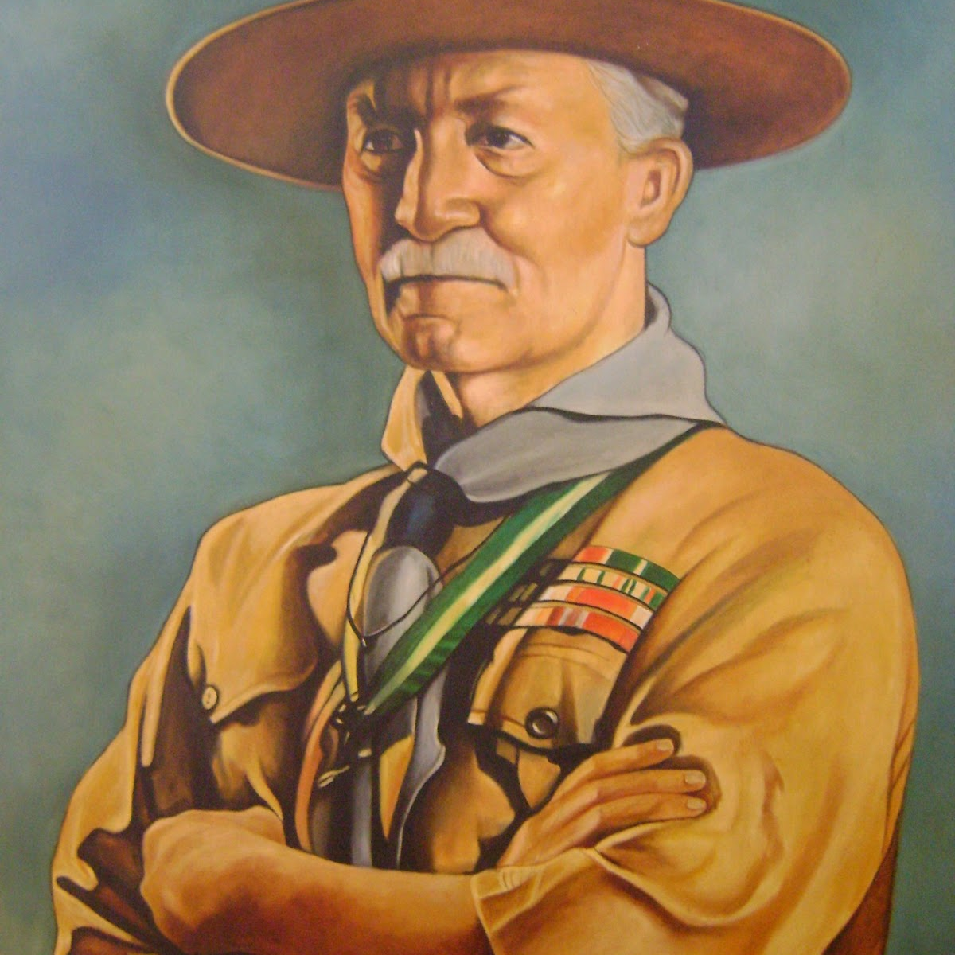
Try and leave this world a little better than you found it, and when you turn comes to dies you can die happy in the feeling that at any rate you have not wasted your time but have done your best.
Robert Stephenson Smyth Bader-Powell, founder of The Scot Association
Notes:
A paraphrase of a Boy Scout rule states that we should always leave the code cleaner than we found it.

Slide 34
Manifesto for Software Craftsmanship
Not only individuals and interactions, but also a community of professionals
Notes:
Not only individuals and interactions, but also a community of professionals
Sharing and mentoring are at the heart of Software Craftsmanship. Software craftsman are passionate and always strive to better themselves. However, we have a far bigger mission: we are responsible for preparing the next generation of craftspeople.
The best way to move our industry forward is by sharing what we learned through mentoring and inspiring less-experience developers. This is also related to the idea of apprentices, journeymen, and masters, where Software Craftsmanship masters will mentor apprentices and help them in their journey. Knowledge, ideas, successes, and failures must be shared and discussed within the community in order to move our industry forward.
Learning from each other is by far the best way for us to become better. Writing blogs, contributing to open source projects, making our code publicly available, becoming part of our local communities, and pairing with other developers are some of the ways we can contribute to the greater good of our industry.

Slide 35
Manifesto for Software Craftsmanship
Not only customer collaboration, but also productive partnerships
Notes:
Not only customer collaboration, but also productive partnerships
A highly motivated team has a much better change to make any project succeed. Passionate and talented people want to succeed and will always find ways to overcome problems and bureaucracy.
Software craftspeople want and need successful projects to build their reputations. We want to be proud of our achievements. Successfully delivering high-quality software and having satisfied customers are essential for a software craftsman’s career.
Although extremely important, writing code well is just one of the things we need to do to help a project to succeed. We must help our clients to improve their processes, provide them with more viable options help them to remove unnecessary bureaucracy, understand their business domain, question their requirements in relation to the value they provide, provide them with good information and knowledge, help them to plan and prioritize work, and work on things that, although they are not coding task, are equally important to the project. Providing value to our customers at all levels is what we mean by having a productive partnership.

Slide 36
Software Craftsmanship is about professionalism in software development.

Slide 37
Technical Debt
Software Craftsmanship for New Developers

Slide 38
What is Technical Debt
Implied cost of additional rework caused by choosing an easy solution
Notes:
Reflects the implied cost of additional rework caused by choosing an easy solution now instead of using a better approach that would take longer
Technical debt can be compared to monetary debt — If not repaid, it can accumulate interest, making it hard to implement changes later on.

Slide 39
Example of Technical Debt
No User Roles
Notes:
You start writing an application. In the beginning there is no need for user roles. Everyone can do anything.

Slide 40
Example of Technical Debt
No User Roles
Permission for Specific Requirement
Notes:
At some point you start having two different permissions for a specific action, like one kind of user can see a report and the others can’t. The tech team considers whether to create a full fledged permission system, using a nice set of design patterns for it. But at this point it really looks like over engineering. One method in the business logic and one in the presentation layer will do.

Slide 41
Example of Technical Debt
No User Roles
Permission for Specific Requirement
Differentiation of Users
Notes:
Some time later another thing requires the differentiation of users, and then another and another. At this point the developers realize that the code is starting to get messy and the solution is refactoring it to have a decent permission system. To make this refactoring will take way more time than just adding another method, but will simplify the code and make future permissions to be added with one line of code, or even by just adding a row in the database.

Slide 42
Example of Technical Debt
No User Roles
Permission for Specific Requirement
Differentiation of Users
Yet Another Permission Change
Notes:
The company has the opportunity to add five customers in a week – but really need another permission change in a couple of days
The problem is that there really is a business need to have the current permission live in one or two days, ‘cause this will make five potential customers sign a contract this week, rather than next week, or maybe never, if they dislike the fact that the company haven’t done their only request.

Slide 43
Common Causes of Technical Debt
Insufficient up-front definition
Notes:
Insufficient up-front definition, where requirements are still being defined during development, development starts before any design takes place. This is done to save time but often has to be reworked later.

Slide 44
Common Causes of Technical Debt
Business pressures
Notes:
Business pressures, where the business considers getting something released sooner before all of the necessary changes are complete, builds up technical debt comprising those uncompleted changes.

Slide 45
Common Causes of Technical Debt
Lack of process or understanding
Notes:
Lack of process or understanding, where businesses are blind to the concept of technical debt, and make decisions without considering the implications.

Slide 46
Common Causes of Technical Debt
Tightly-coupled components
Notes:
Tightly-coupled components, where functions are not modular, the software is not flexible enough to adapt to changes in business needs.

Slide 47
Common Causes of Technical Debt
Lack of a test suite
Notes:
Lack of a test suite, which encourages quick and risky band-aids to fix bugs.

Slide 48
Common Causes of Technical Debt
Lack of documentation
Notes:
Lack of documentation, where code is created without necessary supporting documentation. The work to create any supporting documentation represents a debt that must be paid.

Slide 49
Common Causes of Technical Debt
Lack of collaboration
Notes:
Lack of collaboration, where knowledge isn't shared around the organization and business efficiency suffers, or junior developers are not properly mentored.

Slide 50
Common Causes of Technical Debt
Parallel development
Notes:
Parallel development on two or more branches accrues technical debt because of the work required to merge the changes into a single source base. The more changes that are done in isolation, the more debt is piled up.

Slide 51
Common Causes of Technical Debt
Delayed refactoring
Notes:
Delayed refactoring – As the requirements for a project evolve, it may become clear that parts of the code have become inefficient or difficult to edit and must be refactored in order to support future requirements. The longer that refactoring is delayed, and the more code is added, the bigger the debt.

Slide 52
Common Causes of Technical Debt
Lack of alignment to standards
Notes:
Lack of alignment to standards, where industry standard features, frameworks, technologies are ignored. Eventually, integration with standards will come, doing sooner will cost less (similar to 'delayed refactoring').

Slide 53
Common Causes of Technical Debt
Lack of knowledge
Notes:
Lack of knowledge, when the developer simply doesn't know how to write elegant code.

Slide 54
Common Causes of Technical Debt
Lack of ownership
Notes:
Lack of ownership, when outsourced software efforts result in in-house engineering being required to refactor or rewrite outsourced code.

Slide 55
Common Causes of Technical Debt
Poor technical leadership
Notes:
Poor technological leadership where poorly thought out commands handed down the chain of command increases the technical debt rather than reduce it.

Slide 56
Common Causes of Technical Debt
Last minute specification changes
Notes:
Last minute specification changes; these have potential to percolate throughout a project but no time or budget to see them through with documentation and checks.

Slide 57
Common Causes of Technical Debt
Insufficient up-front definition
Business pressures
Lack of process or understanding
Tightly-coupled components
Lack of a test suite
Lack of documentation
Lack of collaboration
Parallel development
Delayed refactoring
Lack of alignment to standards
Lack of knowledge
Lack of ownership
Poor technical leadership
Last minute specification changes

Slide 58
SOLID Principles
Software Craftsmanship for New Developers

Slide 59
S.O.L.I.D.
First five object-oriented design principles
S – Single-responsibility principle
O – Open-closed principle
L – Liskov substitution principle
I – Interface segregation principle
D – Dependency Inversion Principle
Notes:
These principles, when combined together, make it easy for a programmer to develop software that is easy to maintain and extend. They also make it easy for developers to avoid code smells, easily refactor code, and are also part of the agile.

Slide 60
Single Responsibility Principle (SRP)
A module should have one, and only one, reason to change
Notes:
Might be the least well understood – to easy to hear the name and then assume that it means that every module should do just one thing
There is a principle like that – A function should do one and only one, thing
Historically, the SRB has been described as: A module should have one, and only one, reason to change

Slide 61
Single Responsibility Principle (SRP)
A module should have one, and only one, reason to change

Slide 62
Single Responsibility Principle (SRP)
A module should have one, and only one, reason to change
Notes:
Really referring to one or more people who require a change; final version of SRP is: A module should be responsible to one, and only one, actor

Slide 63
Single Responsibility Principle (SRP)
Notes:
By putting the source code for these three methods into a single Employee class, the developers have coupled each of these actors to the others. This coupling can cause the actions of the CFO’s team to affect something that the COO’s team depends on.
For example, suppose that the CalculatePay function and the ReportHours function share a common algorithm for calculating non-overtime hours. Not wanting to duplicate code, the developers put that algorithm into a function named RegularHours.
Now suppose the CFO’s team decides that the way non-overtime hours are calculated needs to be tweaked. In contrast, the COO’s team in HR does not want that particular tweak because they use non-overtime hours for a different purpose.
A developer is tasked to make the change, and sees the convenient RegularHours function called by the CalculatePay method. Unfortunately, that developer does not notice that the function is also called by the ReportHours function. The developer makes the change and carefully tests its. The CFO’s team validates that the new function works as desired and the system is deployed.
Of course, the COO’s team doesn’t know that this is happen and continue to use the reports generated y the ReportHours function – but now they contain incorrect numbers. Eventually the problem is discovered, and the COO is livid because the bad data has cost his budget greatly.

Slide 64
Open-Closed Principle (OCP)
A software artifact should be open for extension but closed for modification
Notes:
In other words, the behavior of a software artifact ought to be extendable, without having to modify that artifact.
If simple extension to the requirements force massive changes to the software, then the architects of that software system have engaged in a spectacular failure
The OCP is one of the diving forces behind the architecture of systems. The goal is to make the system easy to extend without incurring a high impact of change.

Slide 65
Liskov Substitution Principle (LSP)
Let q(x) be a property provable about objects of x of type T. Then q(y) should be provable for objects y of type y where S is a subtype of T.

Slide 66
Liskov Substitution Principle (LSP)
Let q(x) be a property provable about objects of x of type T. Then q(y) should be provable for objects y of type y where S is a subtype of T.

Slide 67
Liskov Substitution Principle (LSP)
Every derived class should be substitutable for their base class

Slide 68
Liskov Substitution Principle (LSP)
Every derived class should be substitutable for their base class
Notes:
Image that we have a class named License which has a method named CalculateFee, which is called by the Billing application. There are two “subtypes” of License called PersonalLicense and BusinessLicense. They use different algorithms to calculate the license fee.
This design conforms to the LSP because the behavior of the Billing application does not depend, in any way, on which of the two subtypes it uses. Both of the subtypes are substitutable for the License type.

Slide 69
Interface Segregation Principle (ISP)
A client should never be forced to implement an interface that it does not use
Clients should not be forced to depend on methods they do not use
Notes:
Example: Shape interface with area and volume function would violate this principle when applied to something like a Square class. Instead break those apart.

Slide 70
Dependency Inversion Principle (DIP)
Entities must depend on abstractions not on concretions.
Notes:
Entities must depend on abstractions not on concretions. It states that the high level module must not depend on the low level module, but they should depend on abstractions.
Tells us that the most flexible systems are those in which source code dependencies refer only to abstractions, not concretions.

Slide 71
Other Key Principles
Software Craftsmanship for New Developers

Slide 72
DRY – Don’t Repeat Yourself
Every piece of knowledge must have a single, unambiguous, authoritative representation within a system
Notes:
Every piece of knowledge must have a single, unambiguous, authoritative representation within a system
Alternative is to have the same thing expressed in two or more place. If you change one, you have to remember to change the others.
It isn’t a question of whether you will remember: it’s a question of when you will forget

Slide 73
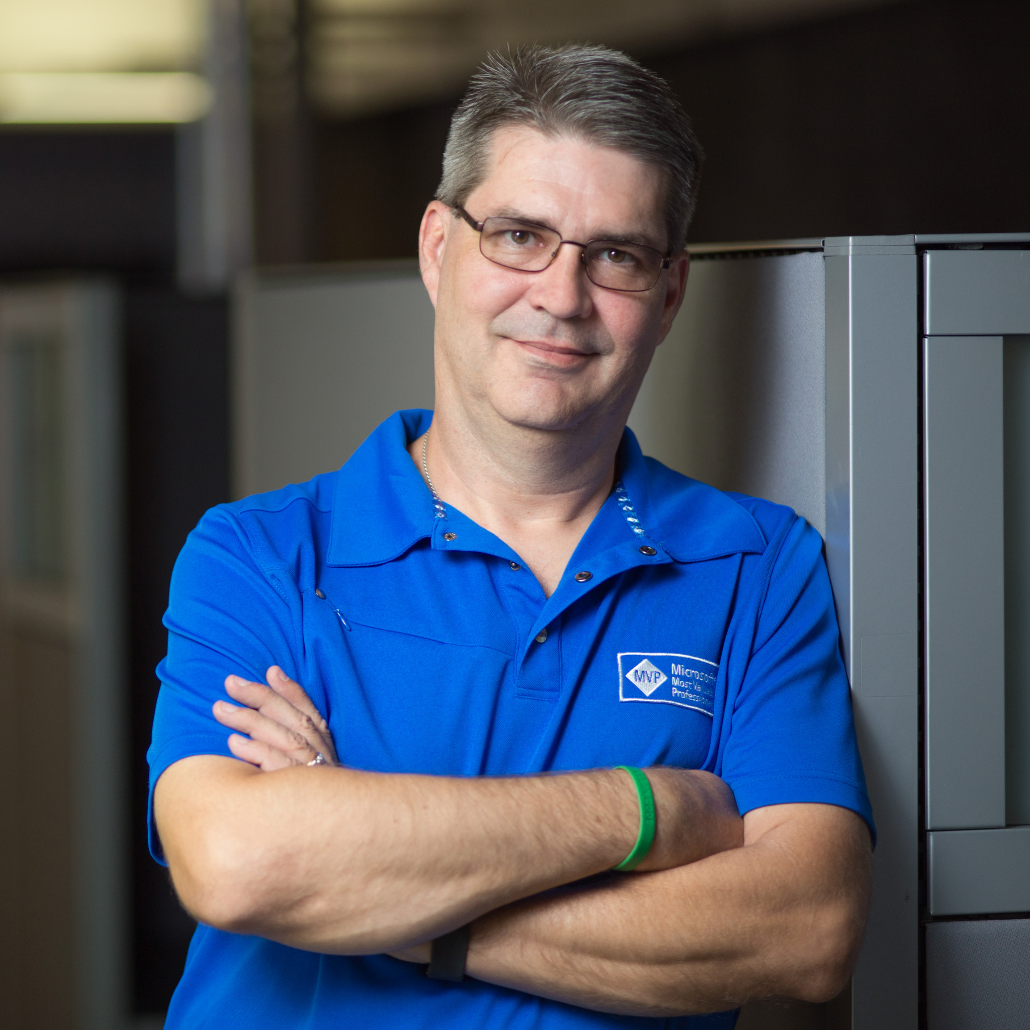
If you write it once, think about encapsulating it.
If you write it twice, you have to encapsulate it.
If your write it three times, programming isn’t for you.
Phil Japikse, Microsoft MVP, ASP Insider, MCSD, MCDBA, PSM II, PSD, CSM, Consultant, Coach, Author, Trainer
Notes:
A paraphrase of a Boy Scout rule states that we should always leave the code cleaner than we found it.

Slide 74
KISS – Keep it Simple Stupid
The simplest explanation tends to be the right one
Notes:
Reportedly coined by Kelly Johnson – lead engineer at the Lockheed Skunk Works (creators of the U-2 and SR-71 sky plans, among many others)

Slide 75
YANGI – You Aren’t Going to Need It
Implement things when you actually need them
Notes:
Always implement things when you actually need them, never when you just foresee that you need them.
Principle behind XP practice of “do the simplest thing that could possibly work”

Slide 76
Key Practices
Software Craftsmanship for New Developers

Slide 77
TDD – Test Driven Development
Repetition of very short development cycle
Requirements turned into very specific test cases
Software is written only to pass new tests
Notes:
Software development process that relies on the repetition of a very short development cycle:
Requirements are turned into very specific test cases
Then, software is written only to pass the new tests

Slide 78
Three Laws of TDD
You are not allowed to write any production code until you have first written a failing unit test

Slide 79
Three Laws of TDD
You are not allowed to write more of a unit test than is sufficient to fail – and not compiling is failing

Slide 80
Three Laws of TDD
You are not allowed to write more code that is sufficient to pass the currently failing unit test

Slide 81
Pair Programing
Two programmers work together at one workstation
Notes:
Technique in which two programmers work together at one workstation
The driver writes code while the observer reviews each line of code as it is typed.

Slide 82
Practicing – Coding Katas
Practice, Practice, Practice
Practice on how to solve the problem
Notes:
When practicing – focus on the techniques you are using and not in solving the problem
Practice on how to solve the problem

Slide 83
Practicing – Coding Katas
Practice, Practice, Practice
Practice on how to solve the problem
Notes:
When practicing – focus on the techniques you are using and not in solving the problem
Practice on how to solve the problem

Slide 84
Practicing – Coding Katas
Practice, Practice, Practice
codingdojo.org/kata
Codekata.com
Codewars.com
Practice on how to solve the problem
Notes:
When practicing – focus on the techniques you are using and not in solving the problem
Practice on how to solve the problem

Slide 85
Code Smells
Software Craftsmanship for New Developers
Notes:
A code smell is any characteristic in the source code that possibly indicates a deeper problem. Determining what is and is not a code smell is subjective, and varies by language, developers, and development methodology.
One way to look at smells is with respect to principles and quality: “Smells are certain structures in the code that indicate violation of fundamental design principles and negatively impact design quality.”
Code smells are usually not bugs; they are not technically incorrect and do not prevent the program from functioning. Instead, they indicate weakness in design that may slow down development or increase the risk of bugs or failures in the future. Bad code smells can be an indicator of factors that contribute to technical debt.
A 2015 study utilizing automated analysis for half a million source code commits and the manual examination of 9164 commits determined to exhibit “code smells” found that:
There exists empirical evidence for the consequences of technical debt, but there exists only anecdotal evidence as to how, when, or why this occurs
Common wisdom suggest that urgent maintenance activities and pressure to deliver features while prioritizing time-to-market over code quality are often the causes of such smells

Slide 86
Code Smells
Comments
Environment
Functions
General
Names
Tests

Slide 87
Code Smells – Comments
Inappropriate Information
Notes:
Inappropriate Information
It is inappropriate for a comment to hold information better held in a different kind of system such as your source code control system, your issue tracking system, or any other record-keeping system.
Change histories just clutter up source files with volumes of historical and uninteresting text.
In general, meta-data such as authors, last-modified-date, SPR number, and so on should not appear in comments.
Comments should be reserved for technical notes about the code and design.

Slide 88
Code Smells – Comments
Obsolete Comment
Notes:
Obsolete Comment
A comment that has gotten old, irrelevant, and incorrect is obsolete.
Comments get old quickly. It is best not to write a comment that will become obsolete.
They become floating islands of irrelevance and misdirection in the code.

Slide 89
Code Smells – Comments
Redundant Comment
i++ // increment i
Notes:
Obsolete Comment
A comment that has gotten old, irrelevant, and incorrect is obsolete.
Comments get old quickly. It is best not to write a comment that will become obsolete.
They become floating islands of irrelevance and misdirection in the code.

Slide 90
Code Smells – Comments
Poorly Written Comment
Notes:
Poorly Written Comment
A comment worth writing is worth writing well. If you are going to write a comment, take the time to make sure it is the best comment you can write. Choose your words carefully. Use correct grammar and punctuation. Do not ramble. Do not state the obvious. Be brief.

Slide 91
Code Smells – Comments
Commented-Out Code
Notes:
Commented-Out Code
Who knows how old it is? Who knows whether or not it’s meaningful? Yet no one will delete it because everyone assumes someone else needs it or has plans for it.
The code sits there and rots, getting less and less relevant with every passing day. It calls functions that no longer exists. It uses variable whose names have changed. It follows conventions that are long obsolete. It pollutes the modules that contain it and distracts the people who try to read it. Commented-out code is an abomination.
When you see commented-out code, delete it. Do not worry, the source code control system still remember it.

Slide 92
Code Smells – Environment
Build Requires More Than One Step
Notes:
Build Requires More Than One Step
Building a project should be a single trivial operation. You should not have to check many little pieces out from source code control. You should not need a sequence of arcane commands or context dependent scripts in order to build the individual elements.
You should be able to check out the system with one simple command and then issue one other simple command to build it.
Continuous Integration

Slide 93
Code Smells – Environment
Build Requires More Than One Step
Notes:
Build Requires More Than One Step
Building a project should be a single trivial operation. You should not have to check many little pieces out from source code control. You should not need a sequence of arcane commands or context dependent scripts in order to build the individual elements.
You should be able to check out the system with one simple command and then issue one other simple command to build it.
Continuous Integration

Slide 94

Code Smells – Environment
Build Requires More Than One Step
Notes:
Build Requires More Than One Step
Building a project should be a single trivial operation. You should not have to check many little pieces out from source code control. You should not need a sequence of arcane commands or context dependent scripts in order to build the individual elements.
You should be able to check out the system with one simple command and then issue one other simple command to build it.
Continuous Integration

Slide 95
Code Smells – Environment
Tests Require More Than One Step
Notes:
Tests Require More Than One Step
You should be able to run all the unit tests with just one command. In the best case you can run all the tests by clicking on one button in your IDE. In the worst case you should be able to issue a single simple command in a shell. Being able to runn all the tests is so fundamental and so important that it should be quick, easy, and obvious to do.
Run tests as part of your automated build process
Visual Studio Enterprise – Live Unit Test

Slide 96
Code Smells – Function
Dead Function
Notes:
Dead Function
Many other function smells
Methods that are never called should be discarded.
Keeping dead code around is wasteful.
Do not worry, your source code control system still remembers it.

Slide 97
Code Smells – General
Obvious Behavior is Unimplemented
Notes:
Obvious Behavior is Unimplemented
Following the principle of Least Surprise, any function or class should implement the behaviors that another programmer could reasonably expect.
Example: Function that translates the name of a day to an enumeration that represents the day
We would expect the string “Monday” to be translated to the Day.Monday enumeration.
We would also expect the common abbreviations to be translated
We would expect the function to ignore case
When an obvious behavior is not implemented, readers and users of the code can no longer depend on their intuition about function names – lose trust in the original author and must fall back on reading the details of the code

Slide 98
Code Smells – General
Incorrect Behavior at the Boundaries
Notes:
Incorrect Behavior at the Boundaries
Seems obvious to say code should behave correctly – problem is that we seldom realize just how completed correct behavior is
Developers often write functions that they think will work, and then trust their intuition rather than going to the effort to prove their code works in all the corner and boundary cases.
There is no replacement for due diligence
Each boundary condition, every corner case, every quirk, and exception represents something that can confound an elegant and intuitive algorithm
Do not rely on your intuition – look for every boundary condition and write a test for it
Example: Mary Ann and testing

Slide 99
Code Smells – General
Overridden Safeties
Notes:
Overridden Safeties
Chernobyl melted down because the plant manager overrode each of the safety mechanisms one by one because they were making it inconvenient to run an experiment. The result was that the experiment did not get run, and the world saw it’s first major civilian nuclear catastrophe.
It is risky to override safeties.
Turning off certain compiler warnings (or all warnings) may help you get the build to succeed, but at the risk of endless debugging sessions
Turning off failing tests and telling yourself you will get them to pass later is as bad as pretending your credit cards are free money

Slide 100
Code Smells – General
Duplication (DRY)
Notes:
Duplication
This is one of the most important rules in software development
Every time you see duplication in the code, it represents a missed opportunity for abstraction
Coding becomes faster and less error prone because you have raised the abstraction level
The most obvious form of duplication is when you have clumps of identical code that look like some programmers went wild with the mouse, pasting the same code over and over again. These should be replaced with simple methods.
A more subtle form are the switch/case or if/else chains that appear again and again in various methods, always testing for the same set of conditions
Still more subtle are modules that have similar algorithms, but do not share similar lines of code – this is still duplication and should be addressed
Find and eliminate duplication wherever you can

Slide 101
Code Smells – General
Dead Code
Notes:
Dead Code
Dead code is code that isn’t executed
Find it in the body of an IF statement that checks for a condition that cannot happen
Find int in the catch block of a try that never throws
Find it in little utility methods that are never called or switch/case conditions that never occur
Problem with dead code is that after awhile it starts to smell. The older it is, the strong and sourer the odor becomes.
This is because dead code is not completely updated when designs change
It still compiles, but it does not follow newer conventions or rules
Written at a time when the system was different
When you find dead code, do the right thing – give it a decent burial; delete it from the system
Static code analysis tools

Slide 102
Code Smells – General
Inconsistency
Notes:
Inconsistency
If you do something a certain way, do all similar things in the same way – goes back to the principle of least surprise
Be careful with the conventions you chose, and once chosen, be careful to continue to follow them
If within a particular function you use a variable named response to hold an HttpResponseMessage, then use the same variable name consistently in other functions that use HttpResponseMessage objects
Simple consistency like this, when reliably applied, can make code much easier to read and modify

Slide 103
Code Smells – General
Clutter
Notes:
Clutter
Of what use is a default constructor with no implementation – all it serves to do is clutter up the code with meaningless artifacts
Variables that are not used
Functions that are never called
Comments that add no information
All these things are clutter and should be removed
Keep your source code clean, well organized, and free of clutter

Slide 104
Code Smells – General
Misplaced Responsibility
Notes:
Misplaced Responsibility
One of the most important decisions a software developer can make is where to put code
Code should be placed where a reader would naturally expect it to be
For example, perhaps we need to print a report with the total or hours that an employee worked – we could sum up those hours in the code that prints the report or we could try to keep a running total in the code that accepts time cards
Clearly, there are sometimes performance reasons why the total should be calculated as time cards are accepted rather than when the report is printed

Slide 105
Code Smells – General
Function Names Should Say What They Do
DateTime newDate = date.add(5)
DateTime newDate = date.AddDays(5)
Notes:
Function Names Should Say What They Do
Look at this code. Would you expect this to add five days to the date? Or is it weeks or hours? Is the date instance changed or does the function just return a new DateTime without changing the old one? You cannot tell from the call what the function does.
If the function adds five days to the date and changes the date, then it should be called something like AddDays
If you have to look at the implementation (or documentation) of the function to know what it does, then you should work to find a better name or rearrange the functionality so it can be placed in functions with better names.

Slide 106
Code Smells – General
Not Following Standard Conventions
Notes:
Follow Standard Conventions
Every team should follow a coding standard based on common industry norms. This coding standard should specify things like where to declare instance variables; how to name classes, methods, and variables; where to put braces; and so on. The team should not need a document to describe these conventions because their code provides the examples.
Everyone on the team should follow these conventions. The means that each team member must be mature enough to realize it does not matter a whit where you put your braces as long as you all agree on where to put them

Slide 107
Code Smells – General
Replace Magic Numbers with Named Constants
3.141592653589793
3.141592753589793
3.141592753589793
Notes:
Replace Magic Numbers with Named Constants
Probably one of the oldest rules in software development
In general it is a bad idea to have raw numbers in your code – you should hid them behind well-named constants
For example
The number 86,400 should be hidden behind the constant SecondsPerDay
If you are printing 55 lines per page, then the constant 55 should be hidden behind the constant LinesPerPage (or a configuration)
Martin talks about common values like 5280 feet per mile; 8 hours per day
What about Pi? - 3.1459265358973
Every time someone see 33141592753589073, they know it is Pi, and so they fail to scrutinize it

Slide 108
Code Smells – General
Functions Doing More Than One Thing
Notes:
Functions Should Do One Thing
It is often tempting to create functions that have multiple second that perform a series of operations. Functions of this kind do more than one thing, and should be converted into many smaller functions, each of which does one thing
CreateOrUpdate method

Slide 109
Code Smells – Names
Undescriptive Names
Notes:
Chose Descriptive Names
Do not be too quick to choose a name – make sure the name is descriptive; remember that meanings tend to drift as software evolves, so frequently reevaluate the appropriateness of the names you chose
This is not just a “feel-good” recommendations – names in software are 90% of what makes software readable. You need to take the time to choose them wisely and keep them relevant. Names are too important to treat carelessly
Example: database table name aliases

Slide 110
CREATE PROCEDURE dbo.HII_Mobile_Cond_Workout_Activities_Log_View
@ID INT = 0,
@cond_workout_ID INT = 0
AS
BEGIN
SELECT al.ID,
al.cond_workout_ID,
al.activity,
al.mins,
al.cal_burn,
a.Category,
ai.ID AS intensity_id,
ai.Intensity
FROM HII_Mobile_Cond_Workout_Activities_Log al
INNER JOIN HII_Cond_Activities a ON a.ID = al.activity
LEFT JOIN HII_Cond_Activities_Intensity ai ON ai.Activity_ID = a.ID AND ai.ID=al.intensity
WHERE al.active=1
AND (cond_workout_ID = @cond_workout_ID OR al.Id = @ID)
ORDER BY al.created_date
END
Notes:
Forget that the name of the procedure and the tables it reference are horrendous (and I formatted this to look a little better); look at how we use alias names that mean almost nothing
Its hard to tell right away what AI, AL, and A mean

Slide 111
CREATE PROCEDURE dbo.HII_Mobile_Cond_Workout_Activities_Log_View
@ID INT = 0,
@cond_workout_ID INT = 0
AS
BEGIN
SELECT al.ID,
al.cond_workout_ID,
al.activity,
al.mins,
al.cal_burn,
a.Category,
ai.ID AS intensity_id,
ai.Intensity
FROM HII_Mobile_Cond_Workout_Activities_Log al
INNER JOIN HII_Cond_Activities a ON a.ID = al.activity
LEFT JOIN HII_Cond_Activities_Intensity ai ON ai.Activity_ID = a.ID AND ai.ID=al.intensity
WHERE al.active=1
AND (cond_workout_ID = @cond_workout_ID OR al.Id = @ID)
ORDER BY al.created_date
END
Notes:
Forget that the name of the procedure and the tables it reference are horrendous (and I formatted this to look a little better); look at how we use alias names that mean almost nothing
Its hard to tell right away what AI, AL, and A mean

Slide 112
CREATE PROCEDURE dbo.HII_Mobile_Cond_Workout_Activities_Log_View
@ID INT = 0,
@cond_workout_ID INT = 0
AS
BEGIN
SELECT al.ID,
al.cond_workout_ID,
al.activity,
al.mins,
al.cal_burn,
a.Category,
ai.ID AS intensity_id,
ai.Intensity
FROM HII_Mobile_Cond_Workout_Activities_Log al
INNER JOIN HII_Cond_Activities a ON a.ID = al.activity
LEFT JOIN HII_Cond_Activities_Intensity ai ON ai.Activity_ID = a.ID AND ai.ID=al.intensity
WHERE al.active=1
AND (cond_workout_ID = @cond_workout_ID OR al.Id = @ID)
ORDER BY al.created_date
END
Notes:
When I look at this at my normal resolution, it is very easy to not see the different between ai and AL
Not to say aliases are bad – especially considering the atrocious table names

Slide 113
CREATE PROCEDURE dbo.GetWorkActivitiesLog
@Id INT = 0,
@WorkoutId INT = 0
AS
BEGIN
SELECT ActivityLog.ID,
ActivityLog.cond_workout_ID,
ActivityLog.activity,
ActivityLog.mins,
ActivityLog.cal_burn,
Activities.Category,
Intensity.ID AS intensity_id,
Intensity.Intensity
FROM HII_Mobile_Cond_Workout_Activities_Log AS ActivityLog
INNER JOIN HII_Cond_Activities AS Activities ON a.ID = ActivityLog.activity
LEFT JOIN HII_Cond_Activities_Intensity Intensity
ON Intensity.Activity_ID = Activities.ID AND Intensity.ID=ActivityLog.intensity
WHERE ActivityLog.active=1
AND (ActivityLog.cond_workout_ID = @WorkoutId OR ActivtyLog.Id = @ID)
ORDER BY ActivityLog.created_date
END
Notes:
Example of a better way to write the same procedure

Slide 114
CREATE PROCEDURE dbo.GetWorkActivitiesLog
@Id INT = 0,
@WorkoutId INT = 0
AS
BEGIN
SELECT ActivityLog.ID,
ActivityLog.cond_workout_ID,
ActivityLog.activity,
ActivityLog.mins,
ActivityLog.cal_burn,
Activities.Category,
Intensity.ID AS intensity_id,
Intensity.Intensity
FROM HII_Mobile_Cond_Workout_Activities_Log AS ActivityLog
INNER JOIN HII_Cond_Activities AS Activities ON a.ID = ActivityLog.activity
LEFT JOIN HII_Cond_Activities_Intensity Intensity
ON Intensity.Activity_ID = Activities.ID AND Intensity.ID=ActivityLog.intensity
WHERE ActivityLog.active=1
AND (ActivityLog.cond_workout_ID = @WorkoutId OR ActivtyLog.Id = @ID)
ORDER BY ActivityLog.created_date
END
Notes:
Still using aliases, but much easier to understand what is what

Slide 115
Code Smells – Names
Encoded Names
intRepeat
repeatCount
Notes:
Avoid Encodings
Names should be encoded with type or scope information
Prefixes such as m_ or f are useless in today’s environments
Today’s environments provide all that information without having to mangle the names
Keep your names free of Hungarian pollution
Some Exceptions: Azure Naming Guidelines

Slide 116
Code Smells – Names
Names Not Describing Side-Effects
public Foo GetFoo() { }
public Foo CreateAndGetFoo() { }
public Foo Create () { }
Notes:
Names Should Describe Side-Effects
Names should describe everything that a function, variable, or class is or does
Do not hide side effects with a name
Do not use a simple verb to describe a function that does more than just that simple action
For example, consider a method called GetFoo which will create the Foo object if it doesn’t exists. A better name would be CreateAndGetFoo (actually it would be better for these to be two separate methods)

Slide 117
Code Smells – Tests
Insufficient Tests
Notes:
Insufficient Tests
How many tests should be in a test suite? Unfortunately, the metric many programmers use is “That seems like enough”
A test suite should test everything that could possibly break

Slide 118
Code Smells – Tests
Not Using a Test Coverage Tool
Notes:
Use a Test Coverage Tool
Coverage tools report gaps in your testing strategy – they make it easy to find modules, classes, and functions that are insufficiently tested
Most IDEs give you a visual indication, marking lines that are covered in green and those that are uncovered in red – this makes it quick and easy to find if or catch statements whose bodies have not been checked
Does not mean that everything must be 100% test covered (exceptions that can never happen)

Slide 119
Code Smells – Tests
Skipping Trivial Tests
Notes:
Don’t Skip Trivial Tests
They are easy to write and their documentary value is higher than the cost to product them

Slide 120
Code Smells – Tests
Not Testing Boundary Conditions
Notes:
Test Boundary Conditions
Take special care to test boundary conditions – we often get the middle of an algorithm right, but misjudge the boundaries

Slide 121
Code Smells – Tests
Exhaustively Test Near Bugs
Notes:
Exhaustively Test Near Bugs
Bugs tend to congregate – when you find a bug in a function, it is wise to do an exhaustive test of that function
You’ll probably find that the bug was not alone

Slide 122
Code Smells – Tests
Tests Should be Fast
Notes:
Tests Should Be Fast
A slow test is a test that will not get run – when things get tight, it is the slow tests that will be dropped from the suite
So do what you must to keep your tests fast

Slide 123
Getting More
Software Craftsmanship for New Developers

Slide 124
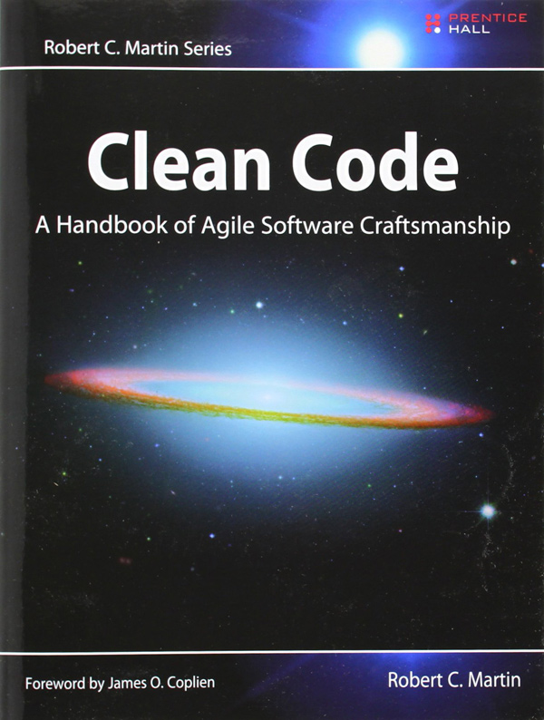

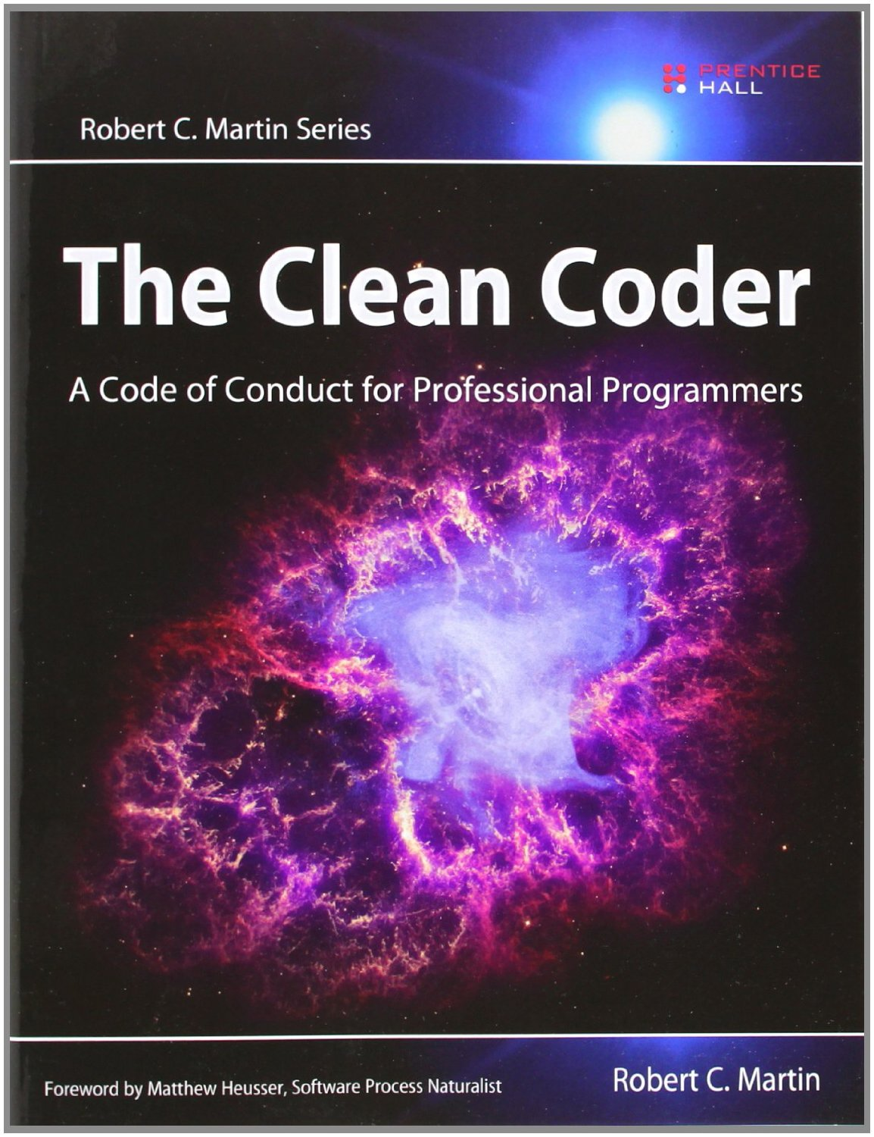
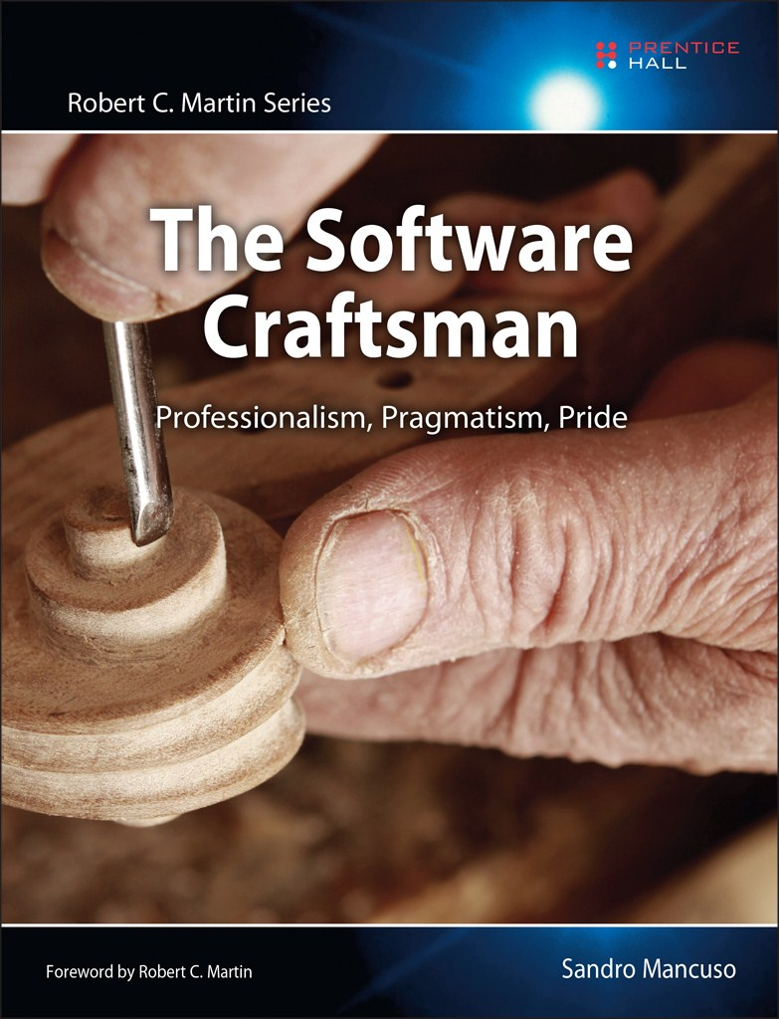

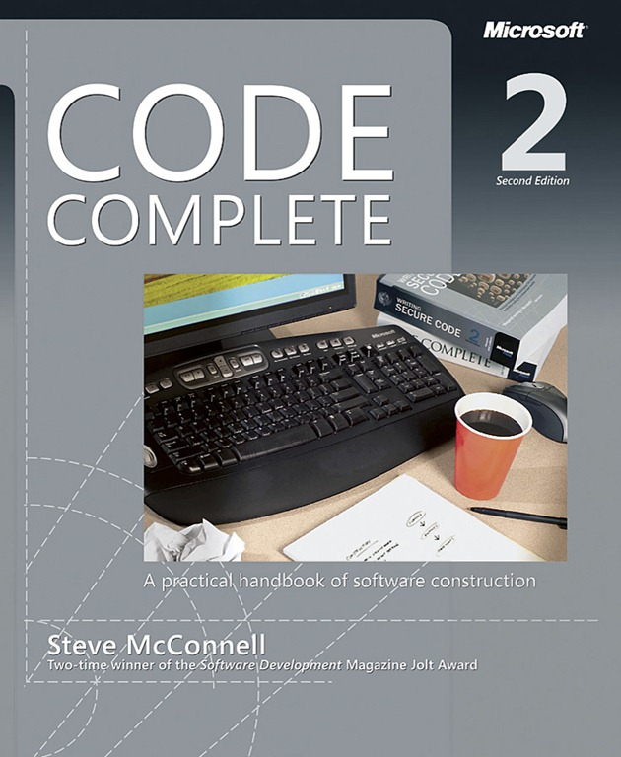
Books
Notes:
Clean Code: A Handbook of Agile Software Craftsmanship – Bob Martin
Clean Architecture: A Craftsman’s Guide to Software Structure and Design – Bob Martin
The Clean Code: A Code of Conduct for Professional Programmers – Bob Martin
The Software Craftsman: Professionalism, Pragamatism, Pride – Sandro Mancuso
The Pragmatic Programmer – Andrew Hunt & Dave Thomas
Code Complete – Steve McConnell

Slide 125





Podcasts
Notes:
Coding Blocks – Allen Underwood, Michael Outlaw, Joe Zack
Herding Code – K. Scott Allen, Kevin Dente, Scott Koon, Jon Galloway
The InfoQ Podcast – Wes Reisz
Developer Tea – Jonathan Cutrell
.NET Rocks! – Carl Franklin and Richard Campbell
Don’t just listen to tech podcasts

Slide 126










Live Coding
MicrosoftDeveloper
VlsualStudio
425show
CodeItLive
ardalis
CLDubya
CodingGarden
BaldBeardedBuilder
CSharpFritz
TaleLearnCode
Notes:
Vendors
Microsoft Developer & Visual Studio
The 425 Show
Code It Live
The Live Coders
Ardalis – Steve Smith
CLDubya – Corey Weathers
CodingGarden – CJ
BaldBeardedBuilder – Michael Jolley
CSharpFritz – Jeff Fritz
TaleLearnCode – Chad Green

Slide 127
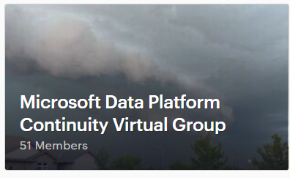
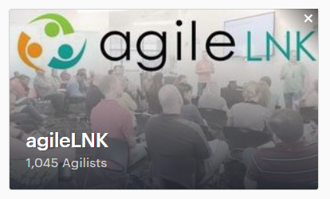
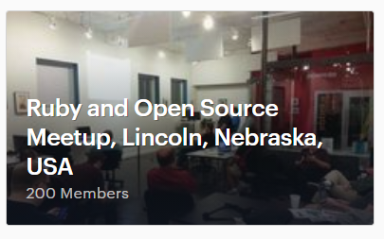
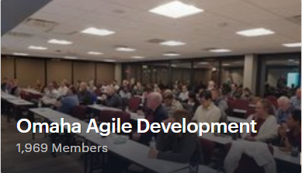
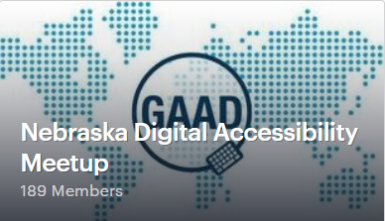
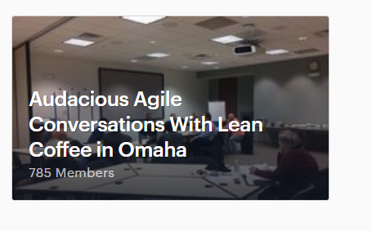
Meetups

Slide 128
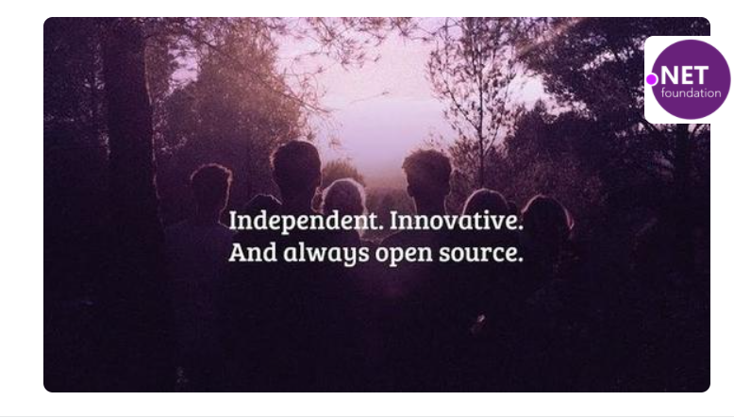
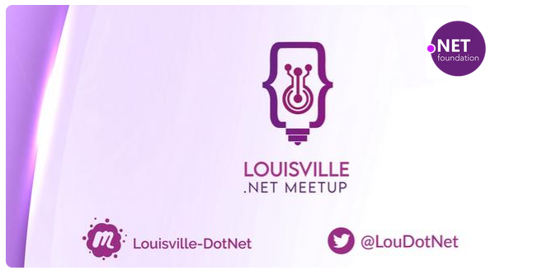
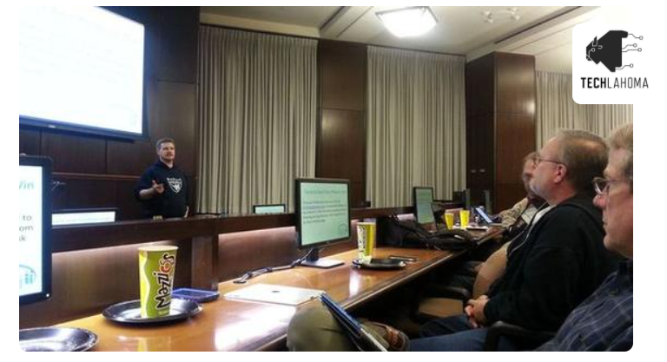
Virtual/Hybrid Meetups
Notes:
.NET Virtual User Group
Louisville .NET Meetup
Tulsa .NET User Group

Slide 129


Conferences
Nebraska.Code() — July 13-15, 2021
Prairie.Code() — September 23-24, 2021
Code PaLOUsa — August 18 – 20, 2021

Slide 130
Software Craftsmanship is about professionalism in software development.

Slide 131
Thank You
chadgreen@chadgreen.com
TaleLearnCode
ChadGreen.com
ChadGreen & TaleLearnCode
ChadwickEGreen

